Slide 1

PRECISION MEDICINE: CLOUD PIPELINE FOR BREAST CANCER DIAGNOSIS AND TREATMENT RECOMMENDATION
Lei Jiang, Deepti Kunupudi, and Michael J. Wolfe

Slide 2
PRECISION MEDICINE
Definition
Individually tailored therapy based on the patient’s disease subtype.
Doctors determine the most appropriate treatment options for patients based on their unique disease profiles.
Advantages
Avoids unnecessary treatments, reduces toxicity, and significantly improves outcome.
Utilize Machine Learning to predict cancer drug responses.
BREAST CANCER DATA
DIAGNOSIS
MACHINE LEARNING

Slide 3

PRECISION MEDICINE
Common Approaches
Drug sensitivity tests
Genomic testing
Identify patient’s gene expression profiles to determine the corresponding sensitive targeted therapies.
Standard in use -
Oncotype DX - Breast cancer
Generates a score of 0-100 based on 21 specific genes in your breast tumor tissue that was removed during surgery.
ordered in over 90 countries for over 900,000 patients.
Biopsy, liquid biopsy
Immunophenotyping
Imaging Tests
Notes:
https://www.mybreastcancertreatment.org/

Slide 4
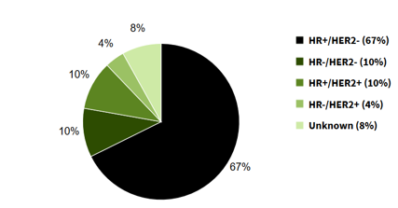
BREAST CANCER - CURRENT TRENDS
Percentage of Female Breast Cancer cases by Cancer Subtype
Notes:
ML for cancer drug response prediction is my job – build custom models and recommender sys
Protein expression difference on tumor cells
Breast cancer subtypes:
HR+/HER2- ("Luminal A")
HR-/HER2- ("Triple Negative")
HR+/HER2+ ("Luminal B")
HR-/HER2+ ("HER2-enriched")
https://seer.cancer.gov/statfacts/html/breast-subtypes.html
HR stands for hormone receptor. HR+ means that tumor cells have receptors for the hormones estrogen or progesterone, which can promote the growth of HR+ tumors. HER2 stands for human epidermal growth factor receptor. HER2+ means that tumor cells make high levels of a protein called HER2/neu, which has been shown to be associated with certain aggressive types of breast cancer.

Slide 5
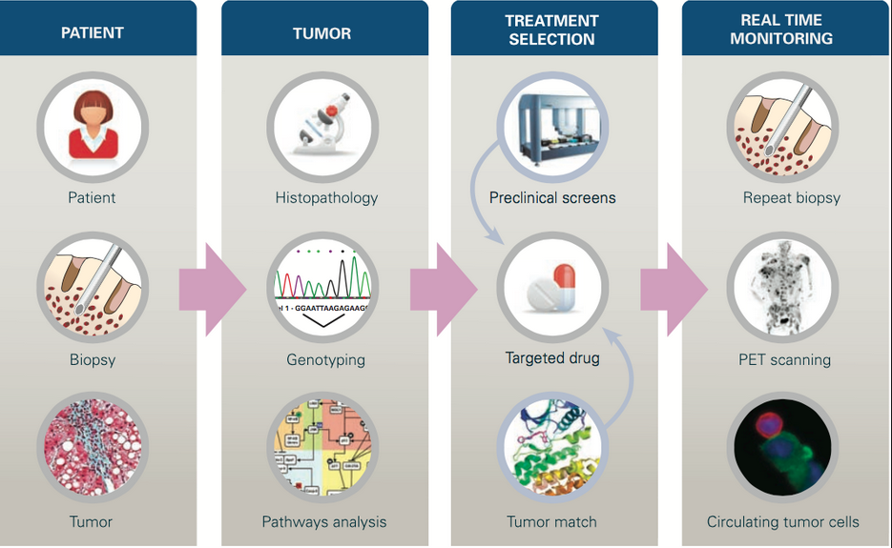
PRECISION MEDICINE

Slide 6
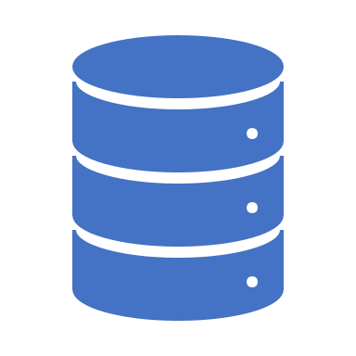
ON-PREMISES CHALLENGES
Lack of existing public integrated bioinformatics database
Existing Bioinformatics Databases are mostly single omics with a few efforts to build integrated databases.
Need to integrate data for cancer patients
Create immunogenomic profiling- Combine patient clinical reports, immunophenotyping and genomic testing data
Data size
Whole Exome Sequencing (WES) data for the human patient can easily reach 10GB-15GB per patient.
Over 100 patients → terabytes of data
Notes:
Data size: the size of the genomics database Sequence Read Archive (SRA) grows from 1 terabyte in 2009 to more than 10,000 terabytes in 2019
Train these model on one single machine is far from ideal.
If use Single giant machine of GPU, is short sighted, coz dataset grow faster than single machine’s capabilities.

Slide 7
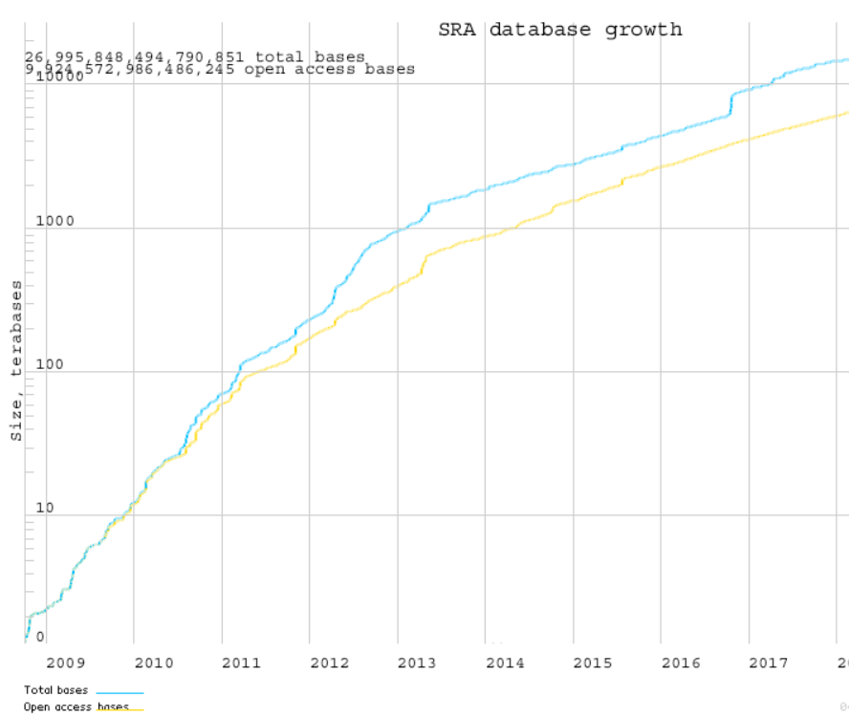
ON-PREMISES CHALLENGES
Genomic and clinical Dataset grow faster than single machine’s capabilities.
Cloud provide the scalability and flexibility for fast growing data.

Slide 8
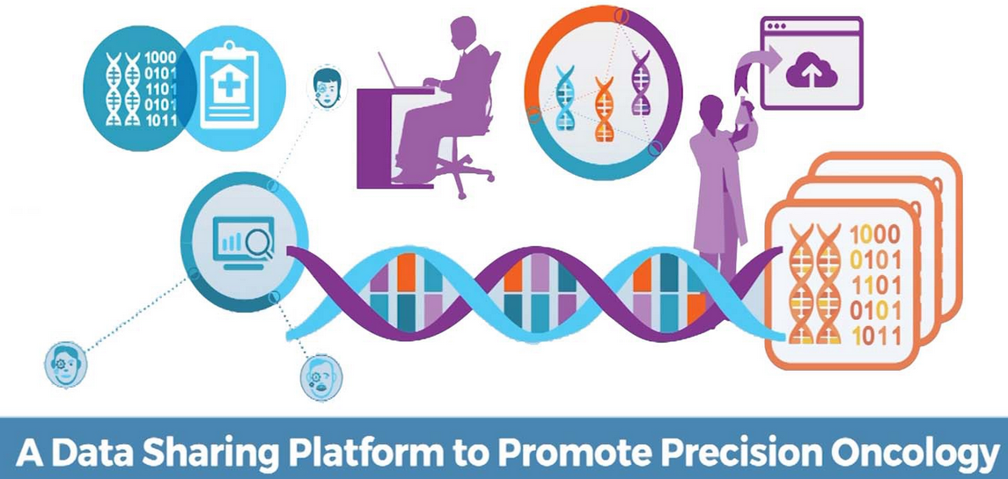
NEED FOR CLOUD
Ideal platform to share info globally
Doctors, patients, data scientist can be in different regions or countries
Diagnosis and treatment recommendations
Reduced Infrastructure Cost
Highly Scalable & More Flexible
Enhanced Security
High Availability

Slide 9
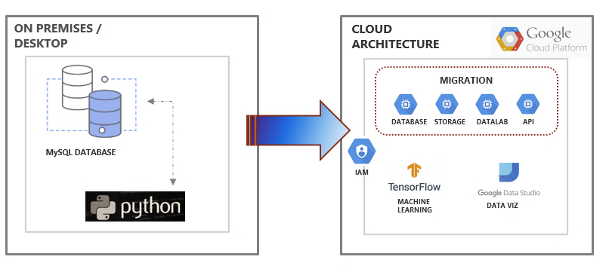
CURRENT ARCHITECTURE VS PROPOSED CLOUD ARCHITECTURE

Slide 10
RUNNING MODELS ADVANTAGES USING CLOUD vs ON-PREMISES
Data storage
Reduce cost
Standard $0.02 – $0.036 per GB/month
Cloud Machine Learning Engine (CMLE)
Cost flexibility
Serverless system, auto-scale on demand, as many as you need
Parameters servers: shared memory, let each trainer learn from all others
Hyperparameters tuning: CMLE remember these hyperparameters
Cloud Datalab – Develop models
Easy to share and collaborate
Easy scale up for fast training time
Gcloud command to submit - scale tier options: basic, standard, basic_GPU, basic_TPU

Slide 11
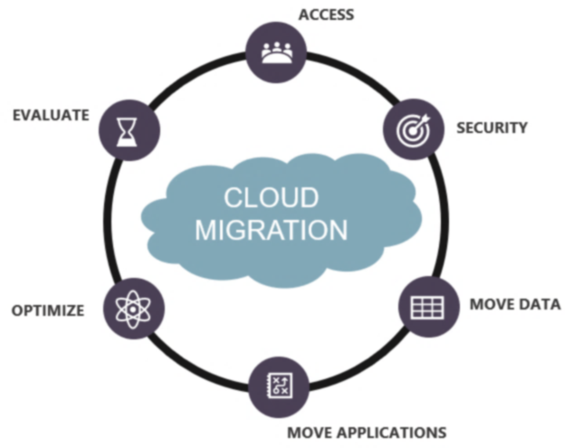
CLOUD MIGRATION STRATEGY

Slide 12
MIGRATION STEPS
Pre-assessment: What do we have?
MySQL database with Biopsy and Genomics data
Machine learning model running in Jupyter Notebook
What do we need?
Data landing zone
Data transformation and rationalization pipeline
Lab Environment to test ML models
Hadoop cluster to run ML pipeline
Database for storing raw data and model metrics
End state dashboard

Slide 13
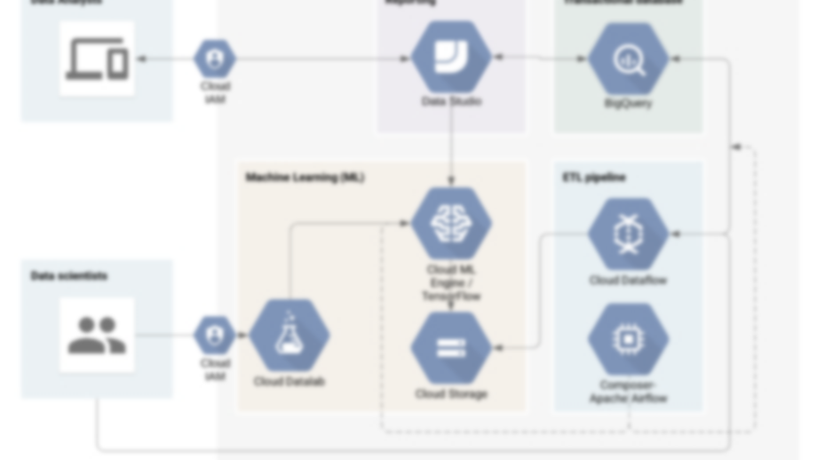
ARCHITECTURE

Slide 14

GOOGLE CLOUD ARCHITECTURE

Slide 15
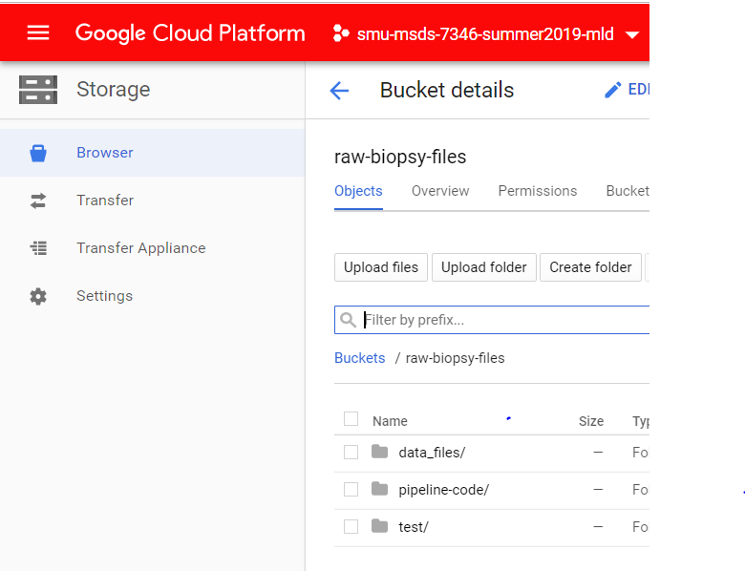
CLOUD STORAGE
Cost
Reduce cost
Standard $0.02 – $0.036 per GB/month
Storage
Unlimited Storage
Functionality
Functional based storage buckets are created.
Leveraged for data migration from on-premises
Acts as a hop for migrating to BigQuery

Slide 16
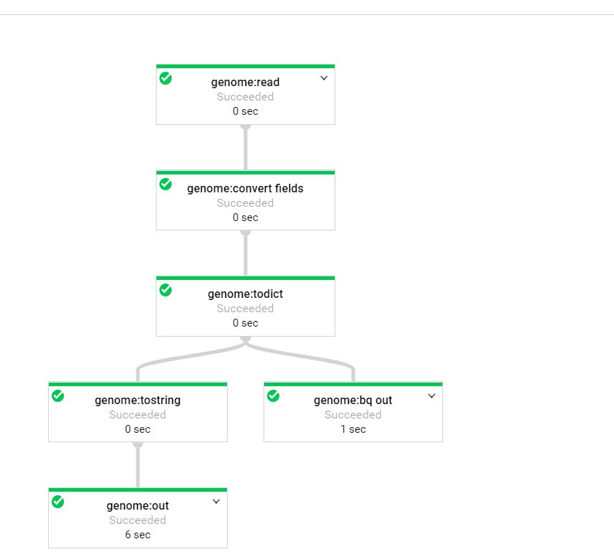
PIPELINES

Slide 17
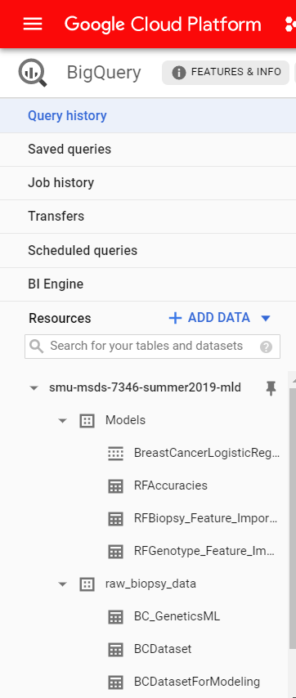
DATABASE - BIGQUERY
Models
Contains transformed data
Supports reporting and model diagnostics
Raw Biopsy Data
Contains untransformed data
Cleansed
Intended for exploration

Slide 18
MACHINE LEARNING USING GCP

Slide 19
PROCESS
EXPLORATARY DATA ANALYSIS
MODEL EVALUATION
INPUT DATA
PRE-PROCESSING / FEATURE ENGINEERING
VALIDATE & DEPLOY

Slide 20
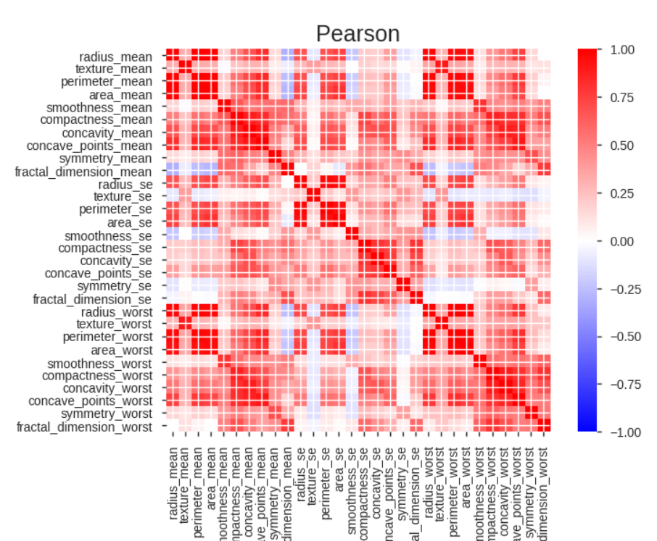
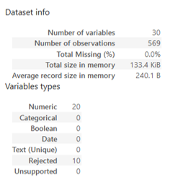
EDA / Feature Selection Using DATALAB
Using DataLab, generated correlation matrix & data exploration for identifying the trends and variations
Identified the correlation between the predictors
Verified the multicollinearity
Considering the most appropriate features.

Slide 21
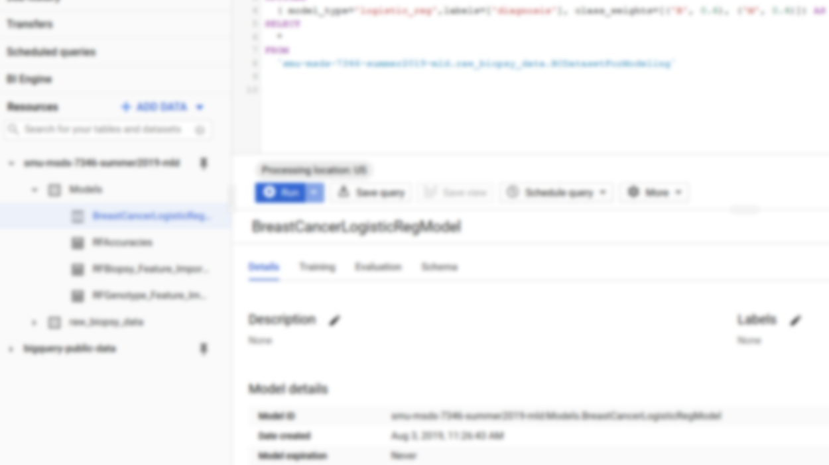
MODEL EVALUATION
BigQuery
Logistic Regression
Random Forest
TensorFlow
Neural networks

Slide 22
DIFFERENT MODEL ACCURACY
97.46%
93.71%
81.32%
Logistic Regression
Random Forest
Neural Network

Slide 23
CONCLUSION
Migration
Cloud Capabilities
Migration Methodology
Integration & Visualization
Monitoring
ML Models
Different models, Different Performance.
Supplementary Evaluation with more additional features and data
Advanced Research on Model and complexity

Slide 24
THANK YOU
https://github.com/mjwolfe91/TeamHealthcareSMU_GCP
24

